Slide 1



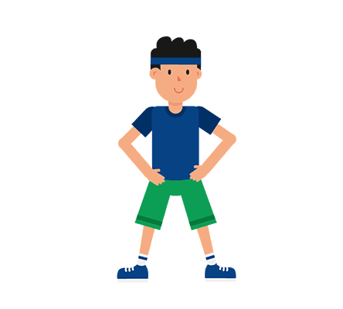

Presented By:- Group - H
Welcome To
A new world of fitness
Speaker : Amritanshu Kumar Singh

Slide 2

Group Members
Presented by :- Group - H
Mentor:- M.D. Sir
Bekrom Roy
Malik Kumar
Amritanshu Kumar Singh
Anurag Kumar Singh
Harikesh Kumar Kori
Saurabh Jha
Sahil Gaurav

Slide 3

PURPOSE
A dream not to make the best Fitness website but to make life healthy through our website. We daily face study & work related issues. Which sometimes make us unhealthy, mentally depressed and stressed out. In this epidemic situation like Corona Virus, Black Fungus , etc. it is important to keep our body healthy and fit. So we thought to create this website to keep you healthy and fit.

Slide 4
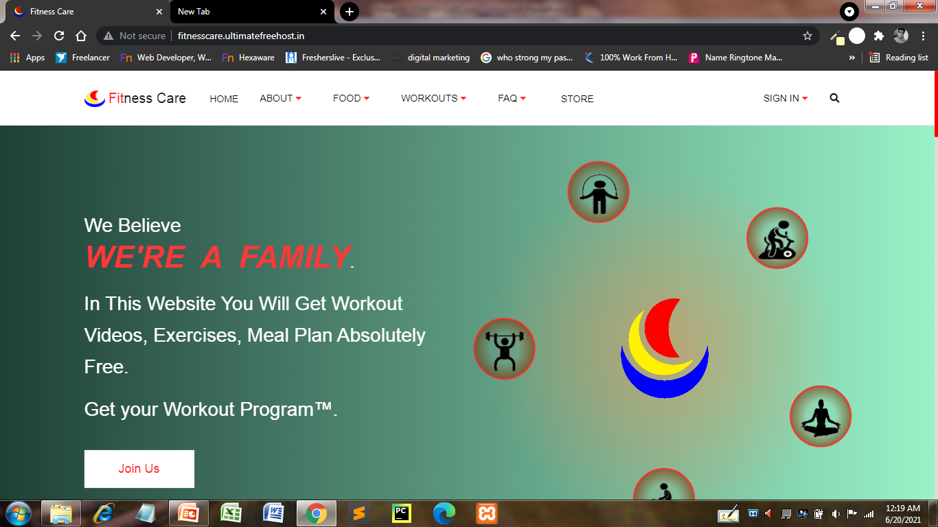
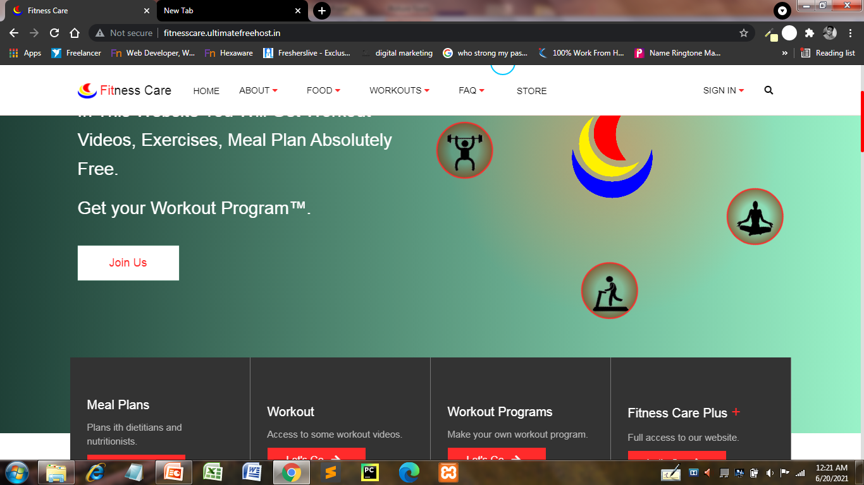
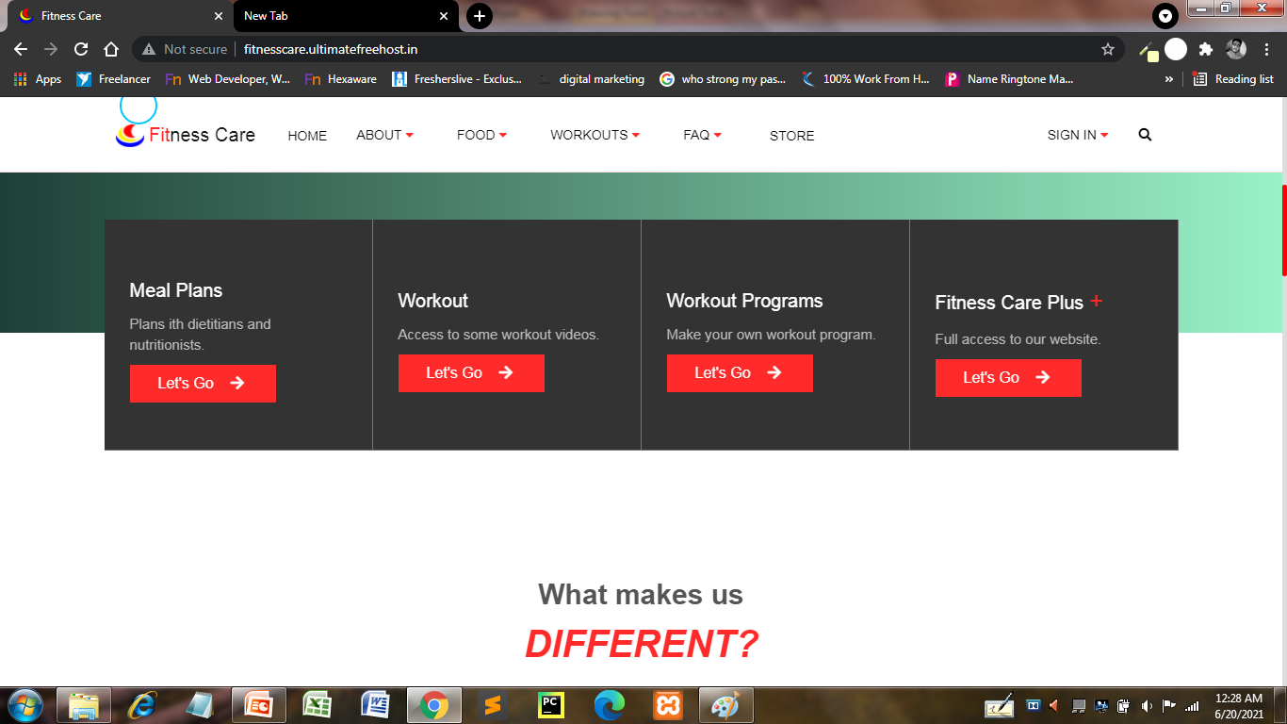
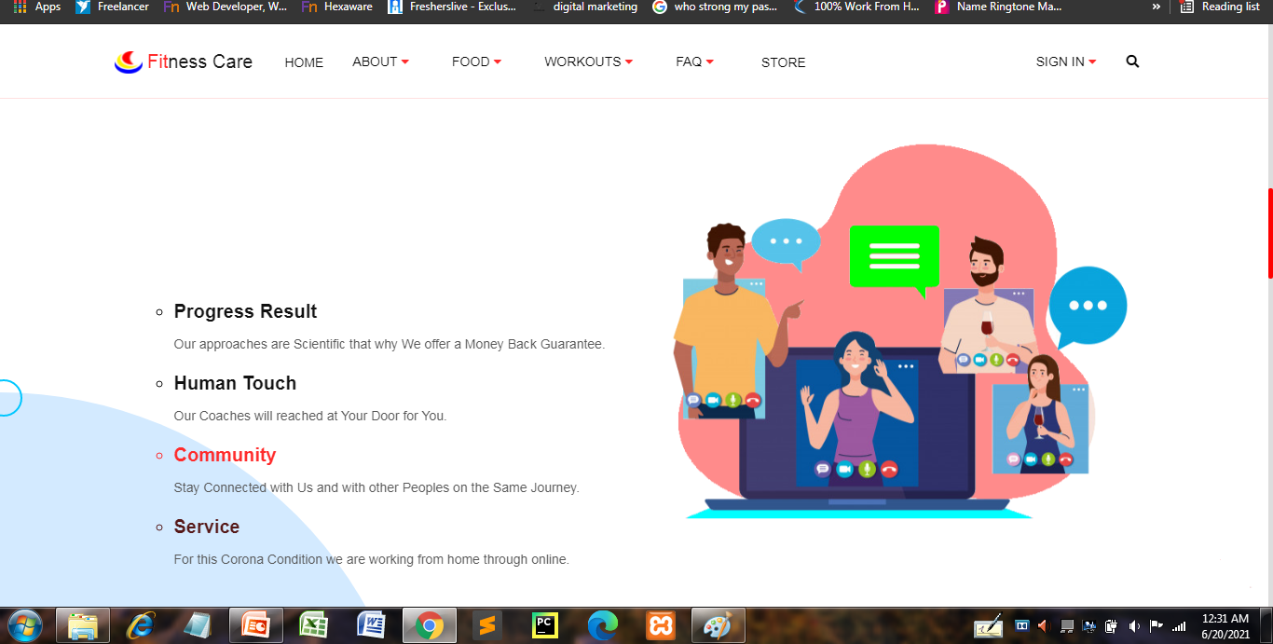
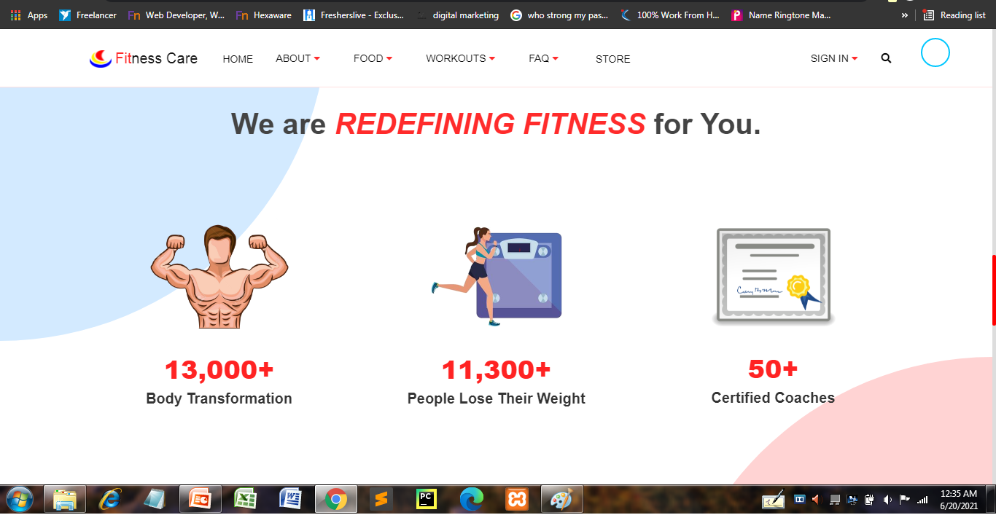
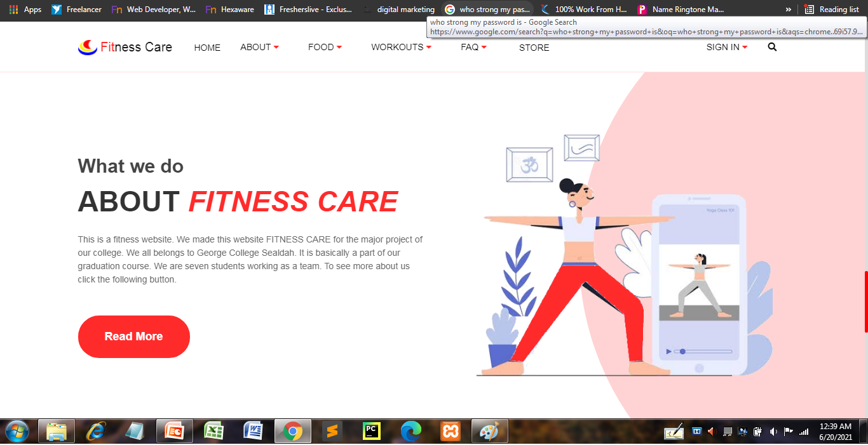
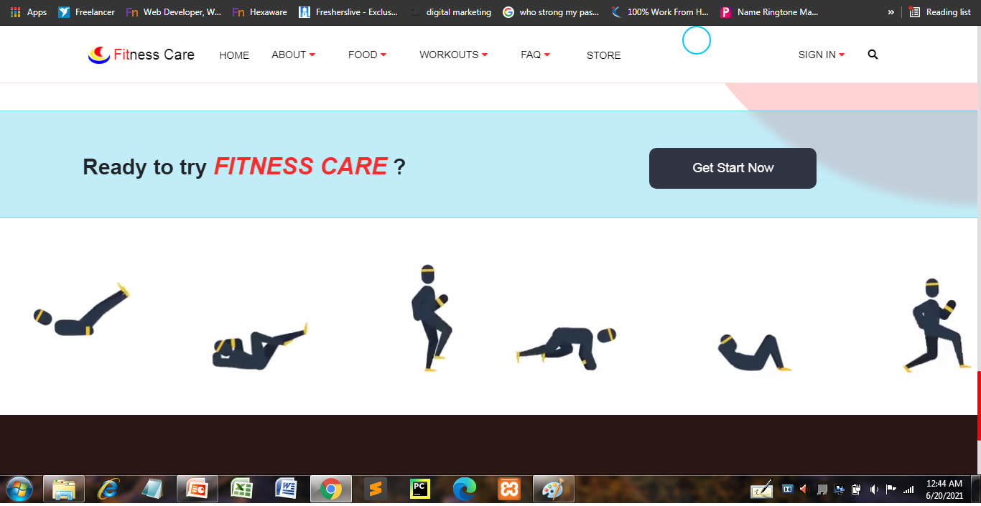
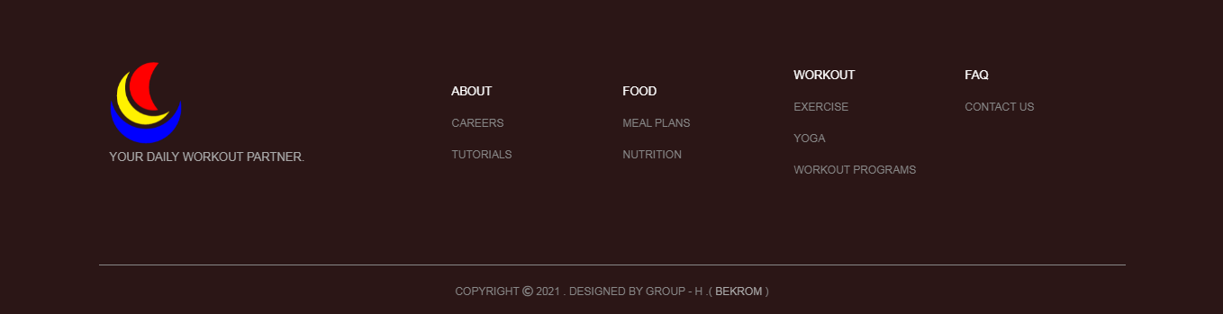
Home Page
This is our Home Page or, index page of our website. This page describes the features and purpose of our website. At this page you will get every details related to our website.

Slide 5
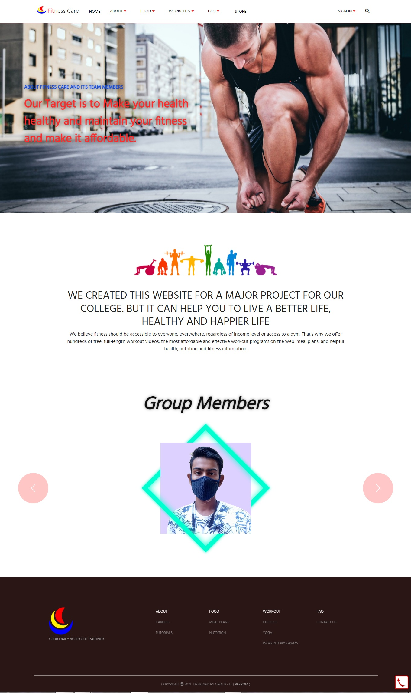
About Us Page
This is About Us Page of our website. This page describes our struggles and our efforts. This page also describes the reason and our dream to make this website.
Next Speaker : Saurabh Jha

Slide 6
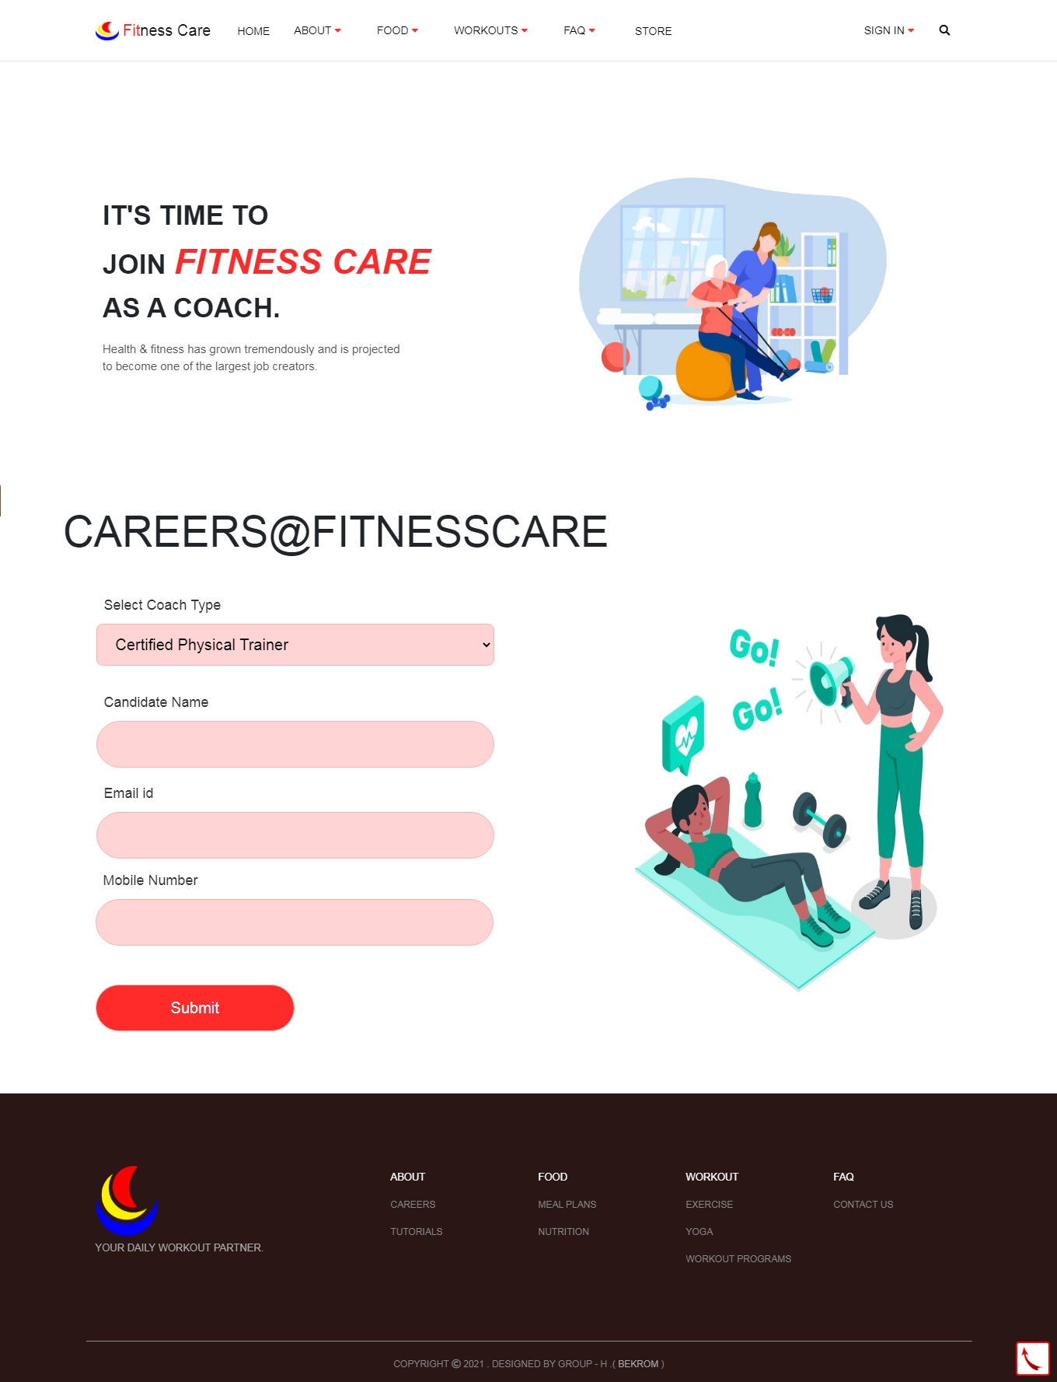
Career Page
If any one from any location wants to start his or her career as a coach or, trainer wit us then he/she can apply through this page. It is career page of our website. Using this page new trainers can reach to us.
Speaker : Saurabh Jha

Slide 7
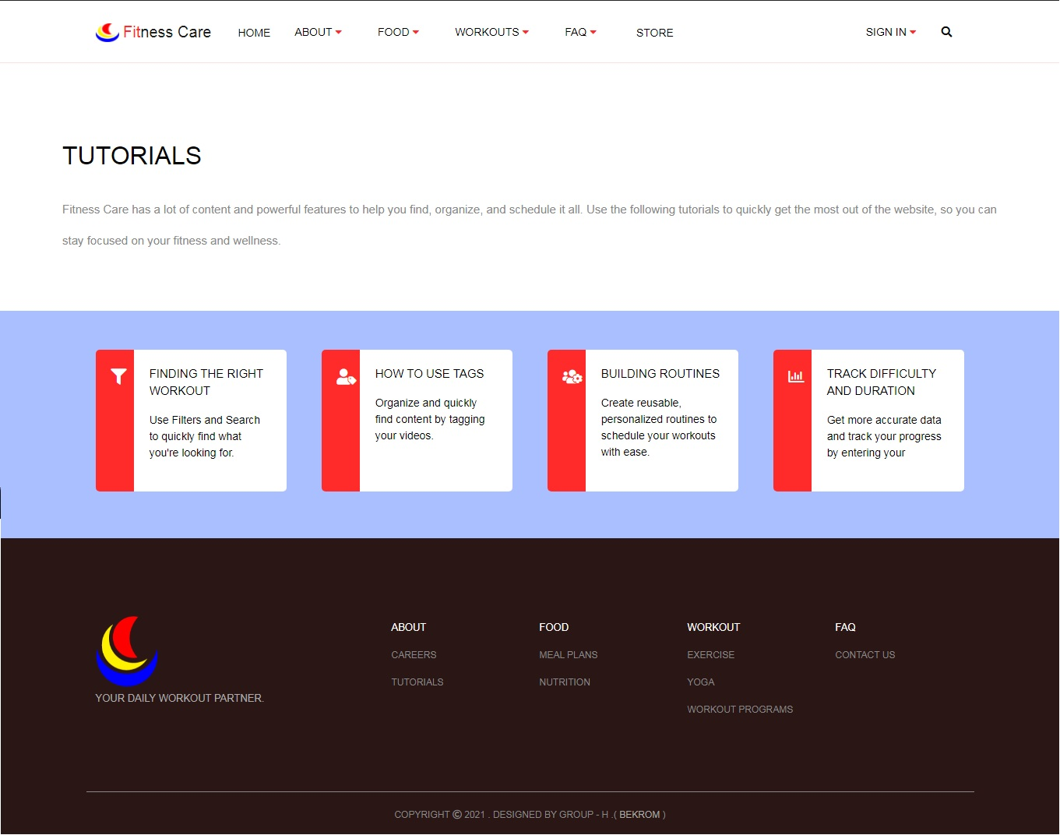
Tutorial Page
This is Tutorial Page of our website. This page is specially made for the beginners, who don’t know from were to start and what will be their next step. By using this page they can start easily.

Slide 8
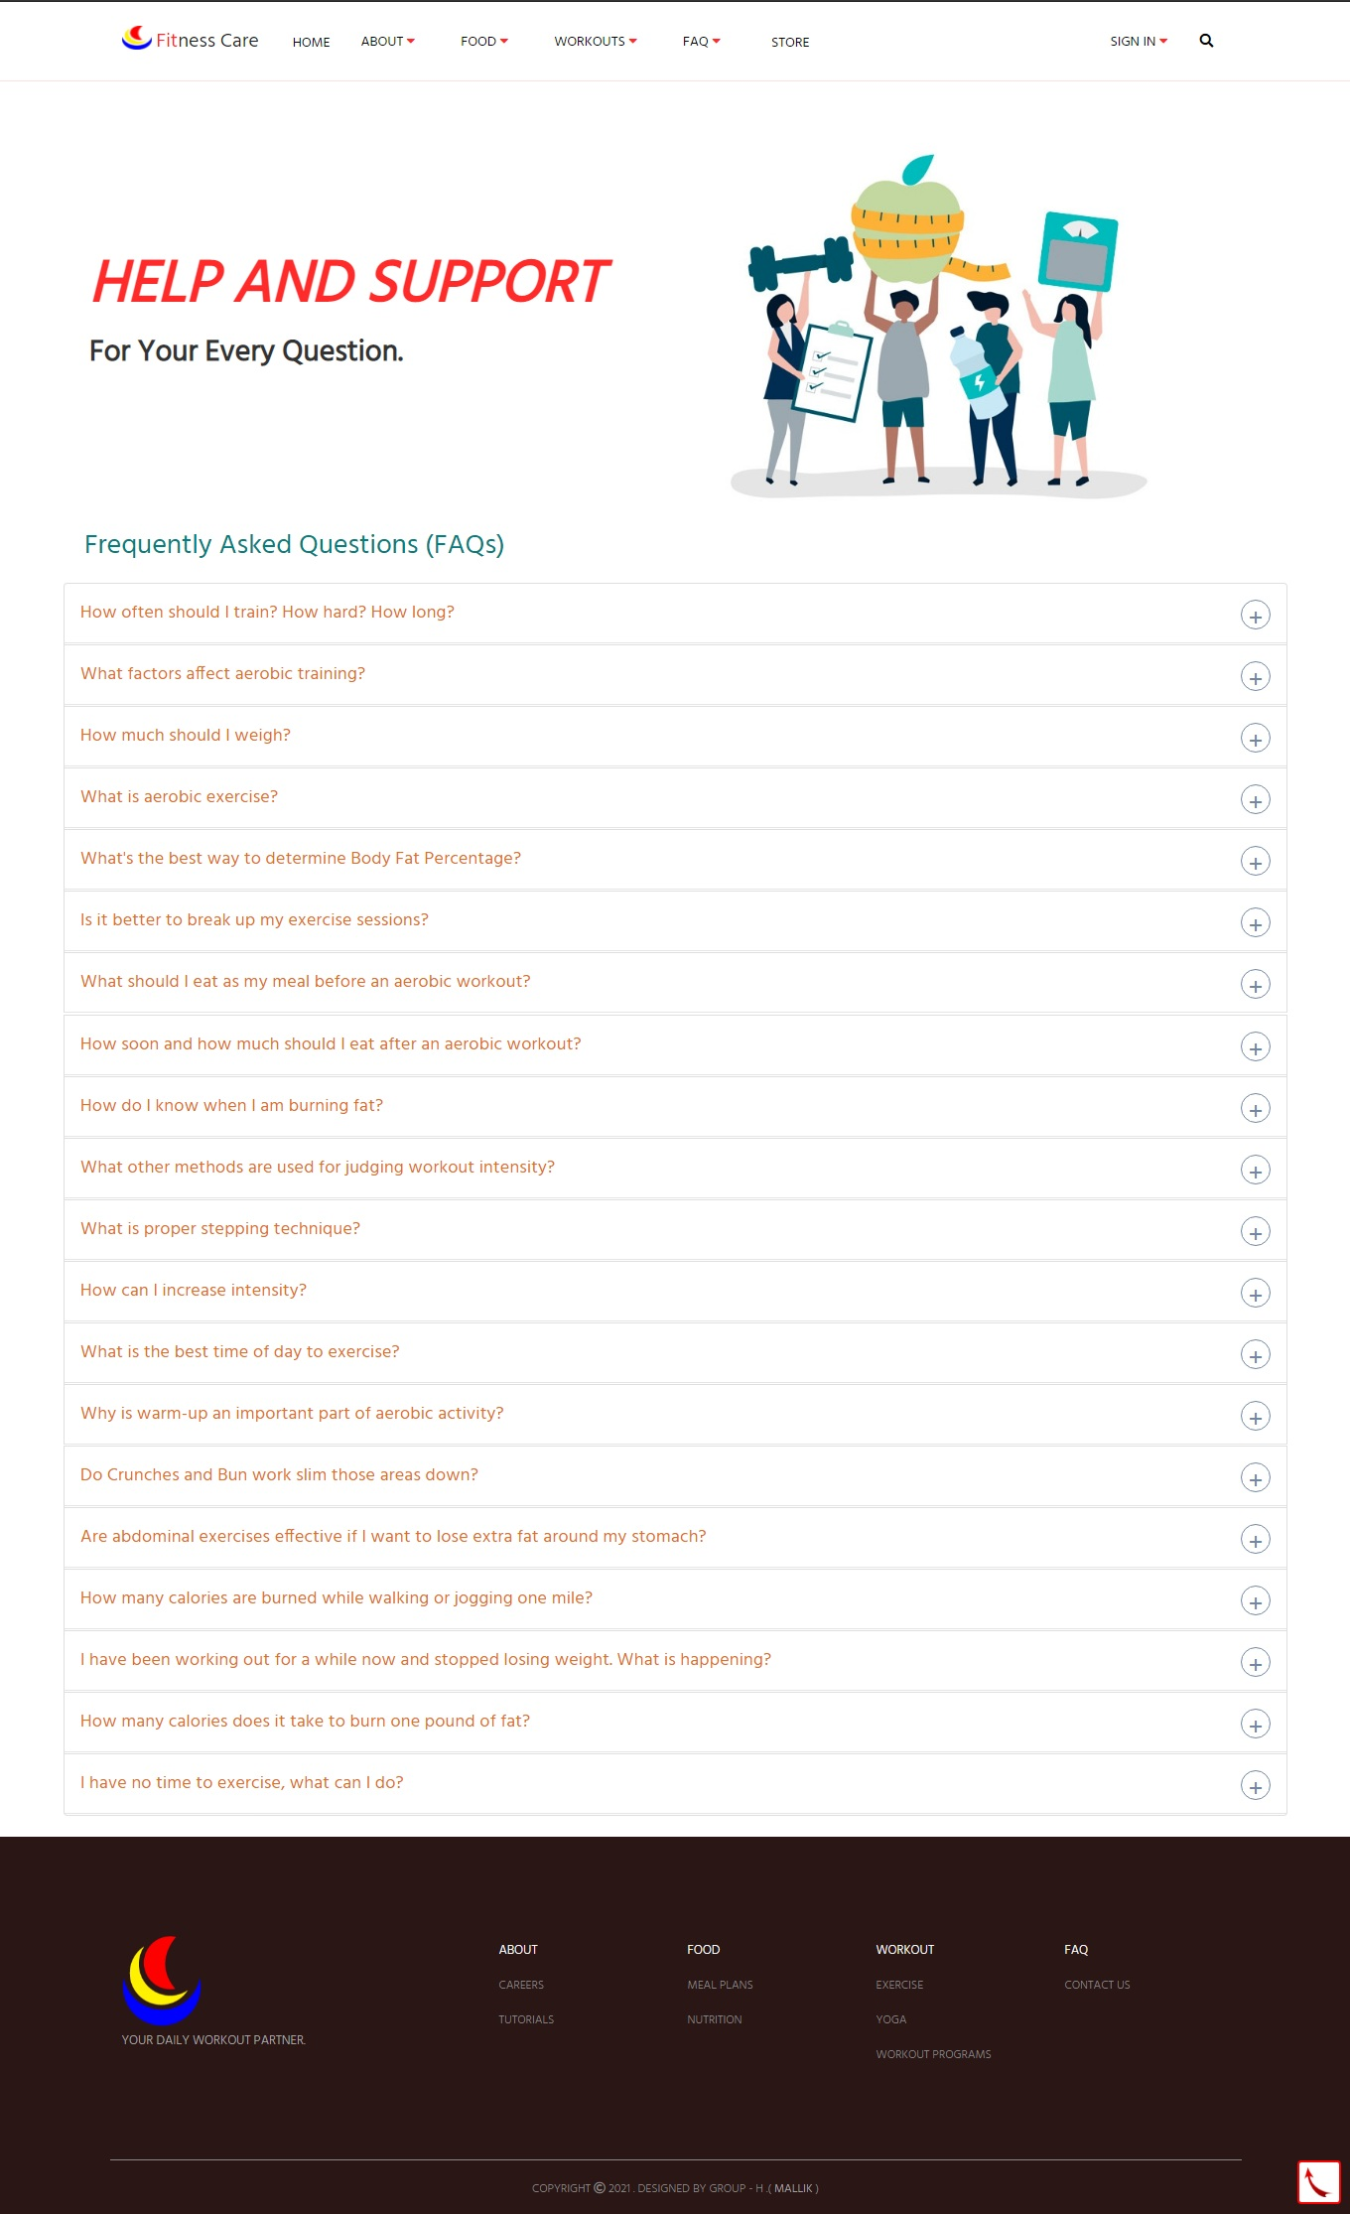
FAQ Page
It is FAQ Page of our website. This particular webpage on our website will make easy for the user to understand and use our tools. Here the user can learn more about the website and also about the exercise.
Next Speaker : Malik Kumar

Slide 9
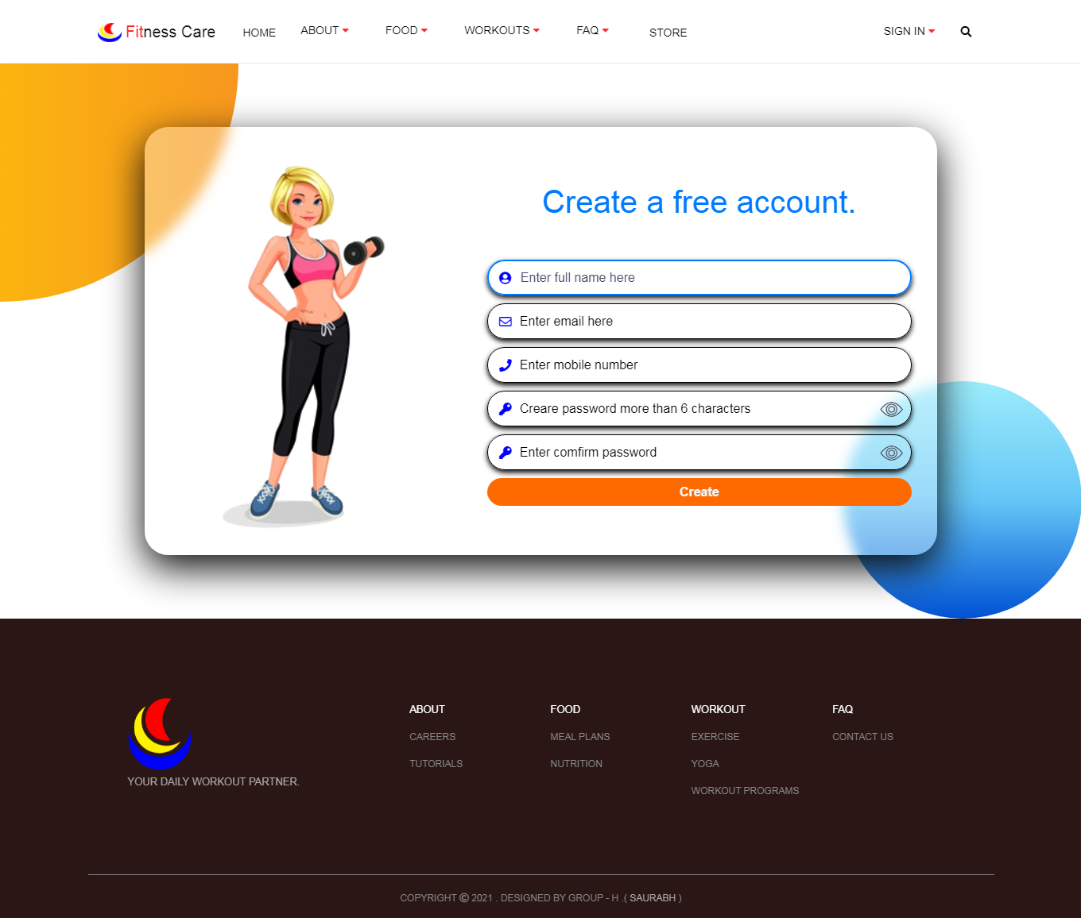
Register Page
This is register or, signup page of our website. This page has a connection with database. Using this page user can create his account. And active his account by email verification.
Speaker : Malik Kumar

Slide 10
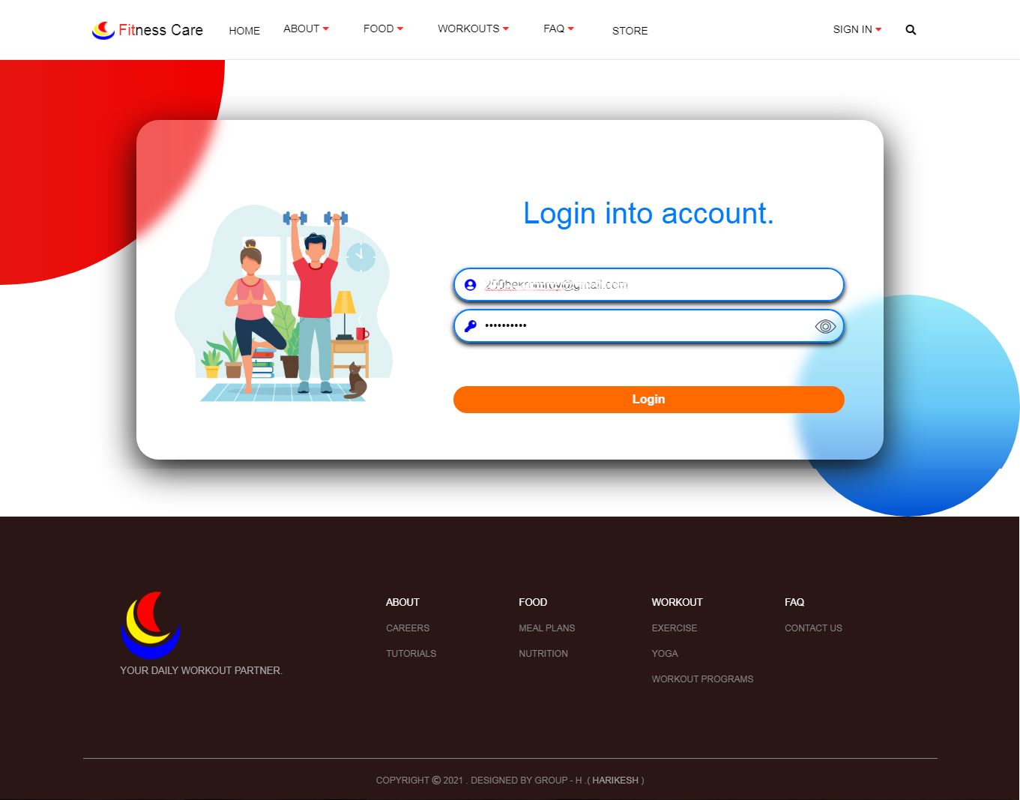
Login Page
It is login page of our website. By using this page user can get into his account. This page uses cookies. It stores the user email id and his password for a certain period of time.

Slide 11
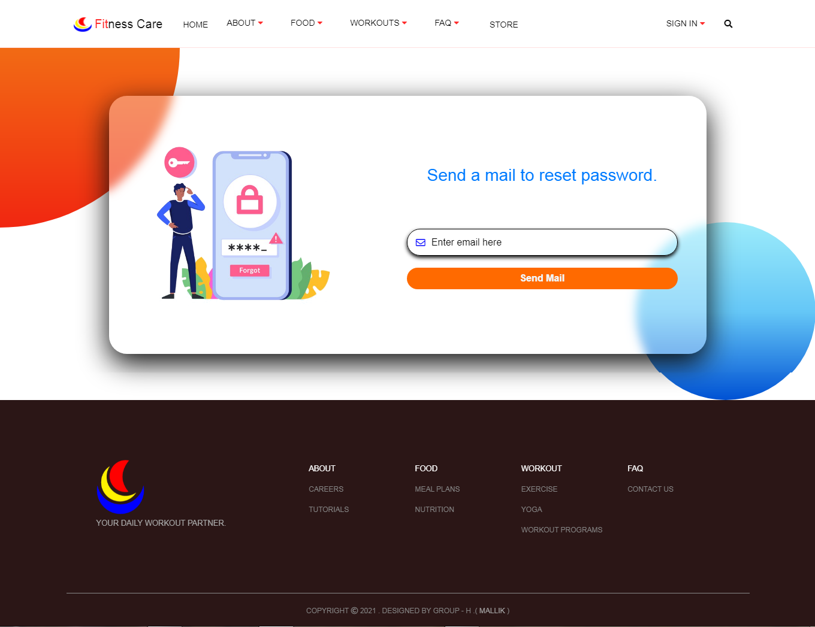
Forgot Password Page
This is forgot password page of our website. If the user forget his password then they can easily reset their password by entering his mail id. We will send him our reset password page link via mail id. And from their he can change his password.

Slide 12
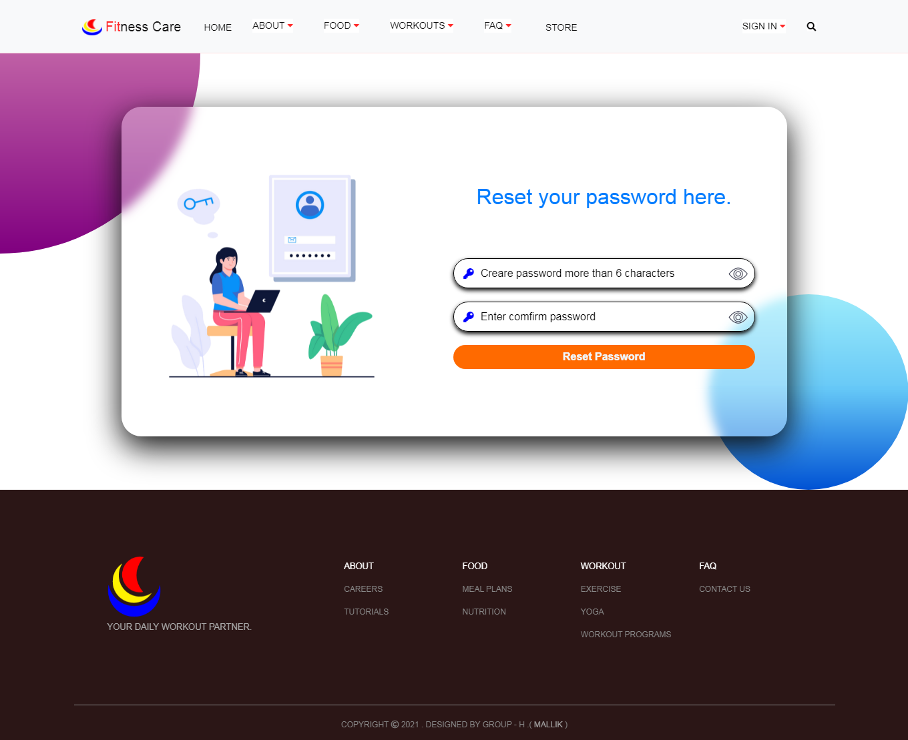
Reset Password Page
This is our reset password page of our website. When user enter his mail id at forgot password page then he will get a link of this page and from their he can update his new password.

Slide 13
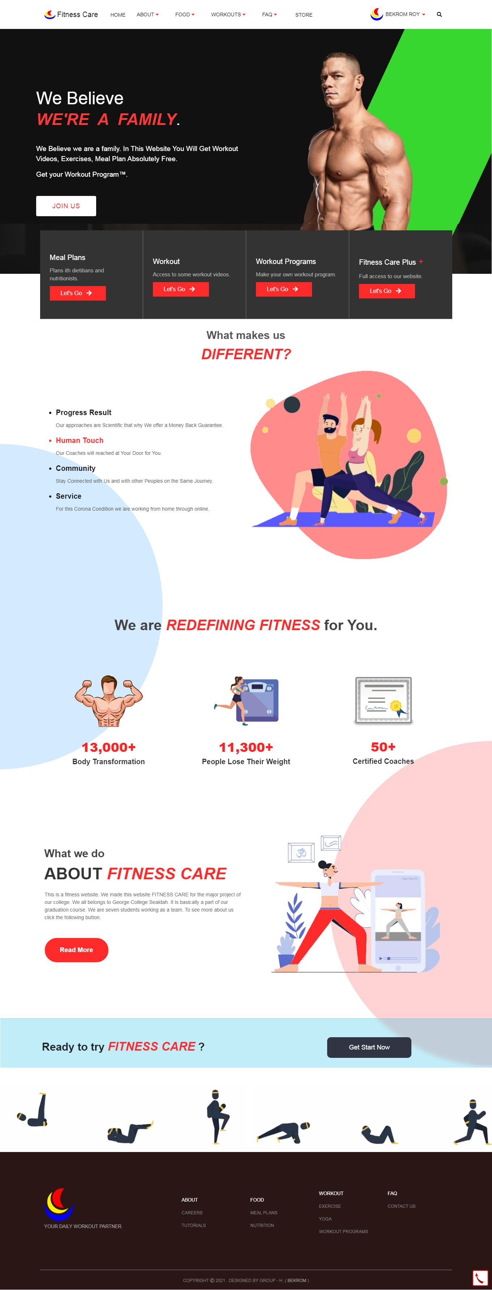
Dashboard Page
This is dashboard of our website. When user login into his account then only he can get into this page. Without login they can not get into this page.
Next Speaker : Anurag Kumar Singh

Slide 14
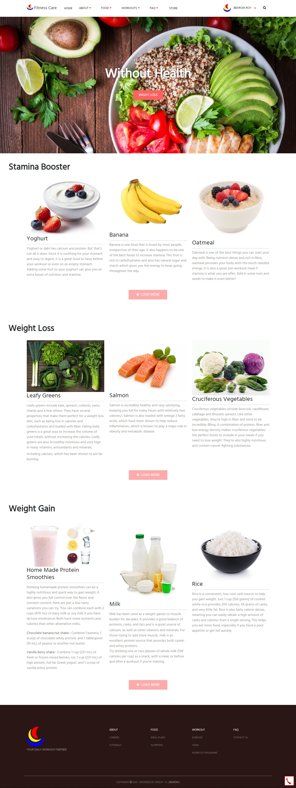
Nutrition Page
It is one of the important page of our website. It is Nutrition Page of our website. At this page we mentioned three types of food like stamina booster, weight loss, weight gain.
Speaker : Anurag Kumar Singh

Slide 15
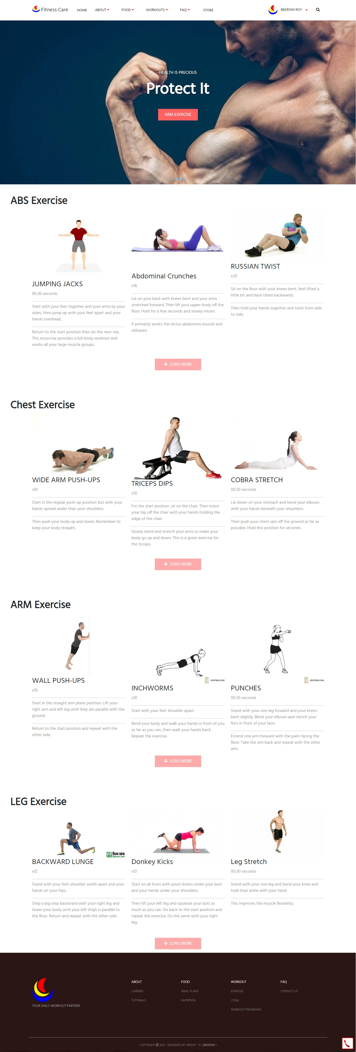
Exercise Page
It is Exercise Page of our website. At this page we mentioned different types of exercises from beginner level to expert level exercise.

Slide 16
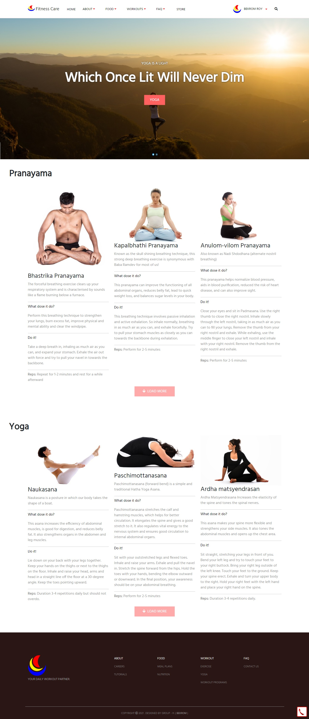
Yoga/Pranayama Page
We believe Yoga is a mindful movement practice that encompasses stretching, strengthening poses, meditation, and breathing exercise. At this page we mentioned different types of Yoga and Pranayama. This are recommended by the experts.
Next Speaker : Harikesh Kumar Kori

Slide 17
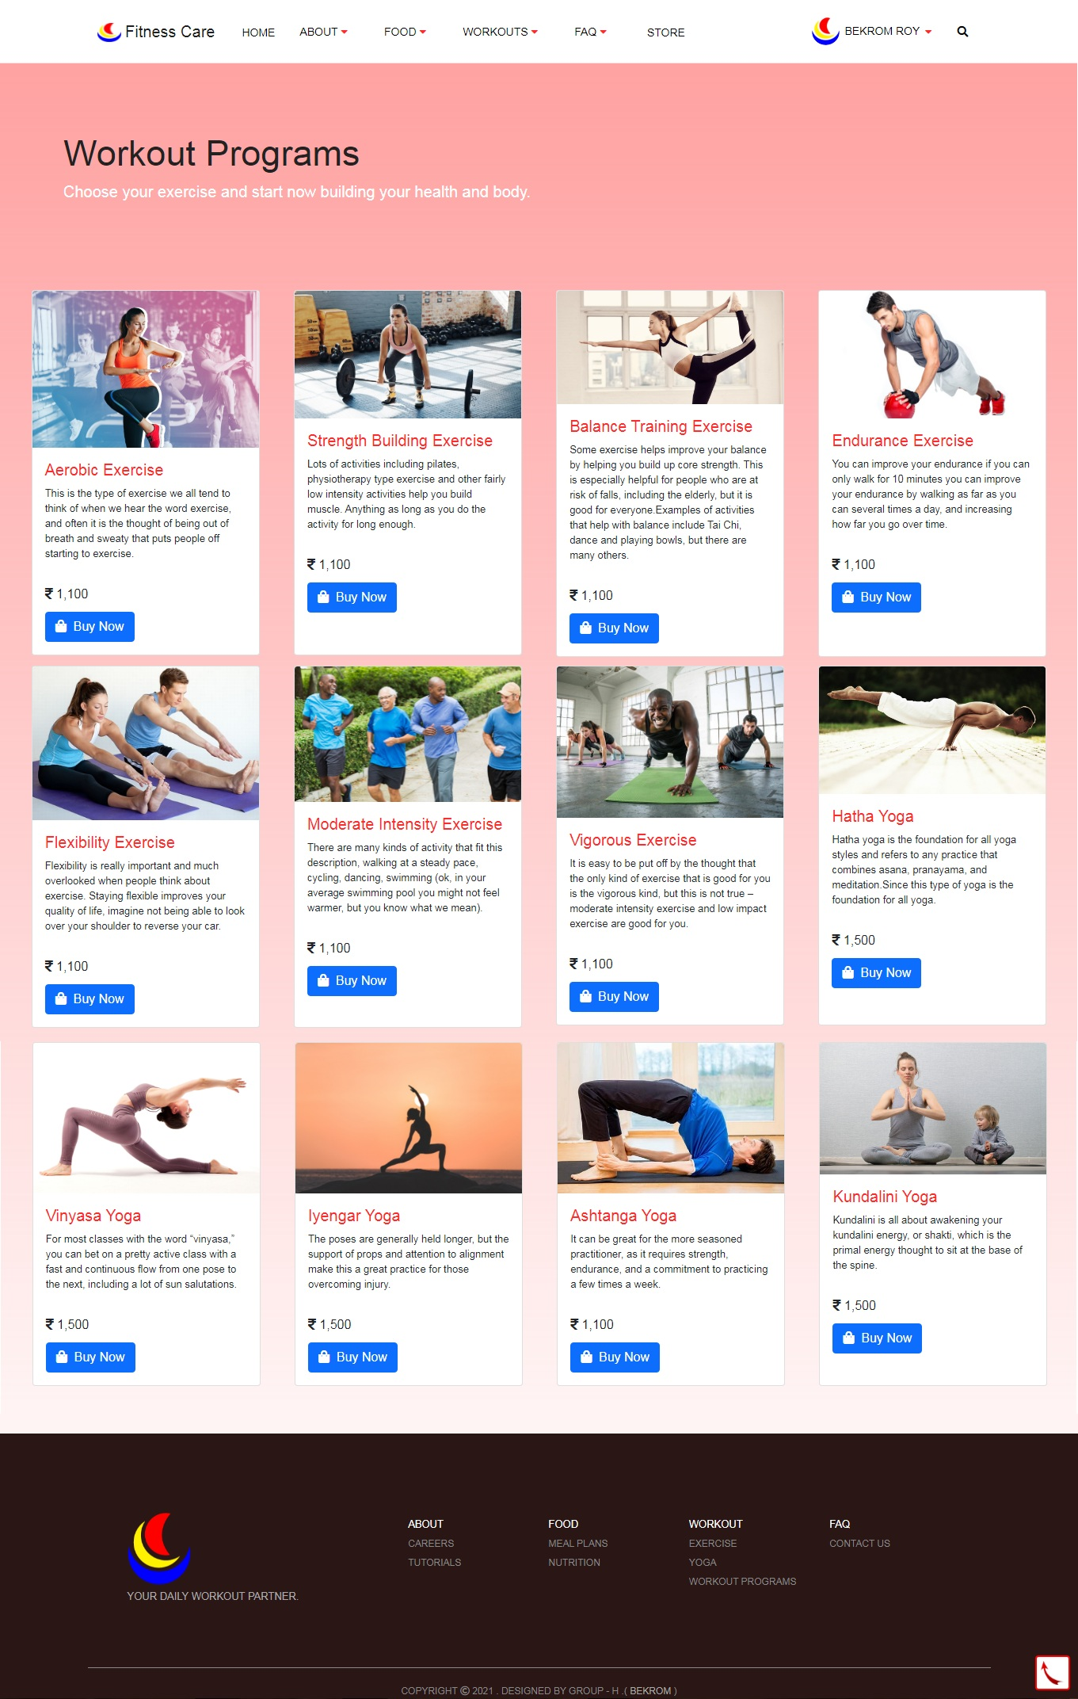
Workout-Program Page
This is Workout program Page of our website. Here we mentioned different types of workout & yoga program plans. This plans are not free plans.
Speaker : Harikesh Kumar Kori

Slide 18
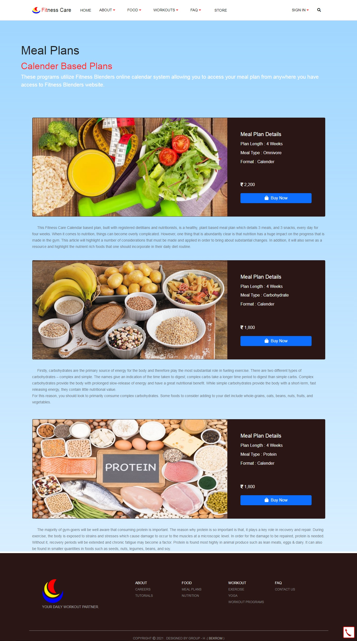
Meal-Plan Page
This is Meal Plan Page of our website. Sometimes beginners usually face problems about their diet chart. This page for help them to create diet chart.

Slide 19
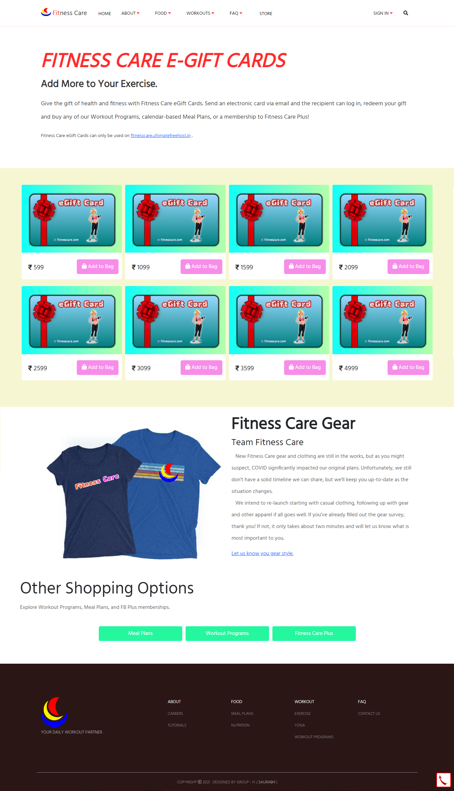
Store Page
It is store Page of our website. At this page user can purchase eGift cards. By using this cards user can buy any premium plans at our website.
Next Speaker : Sahil Gaurav

Slide 20
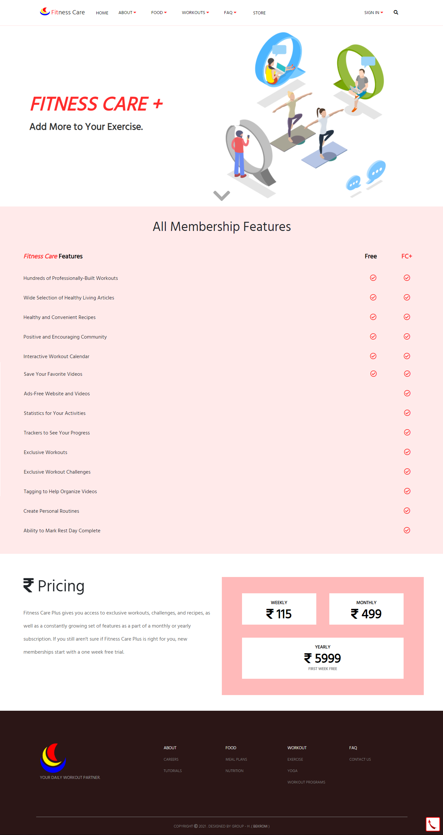
Fitness Care Membership Page
This is Membership Page of our website. This page define the difference between normal user and premium user. At this any user can take premium plans for a week, month and a year.
Speaker : Sahil Gaurav

Slide 21
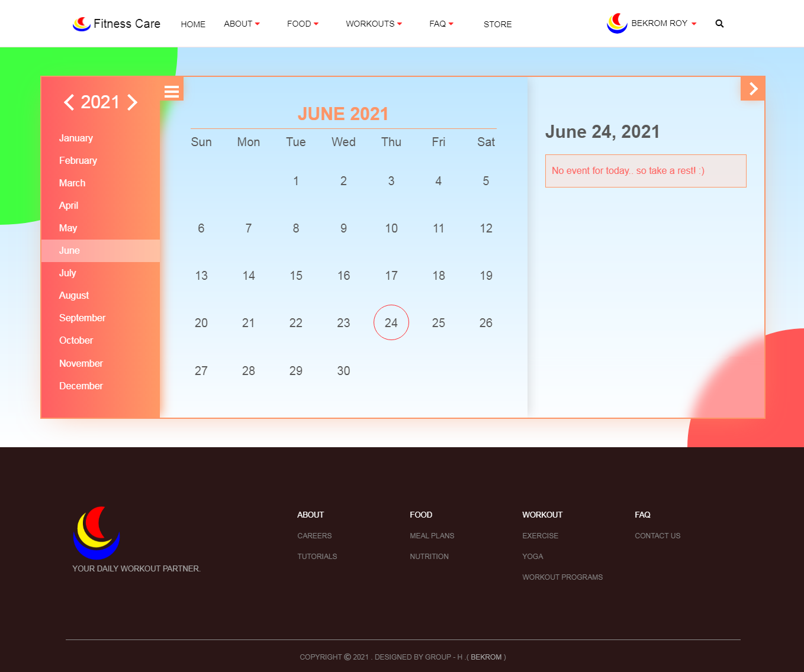
Calendar Page
This is calendar for the user who wants to make his plans for exercise using calendar. Our every plan of our website follows this calendar.
Next Speaker : Bekrom Roy

Slide 22
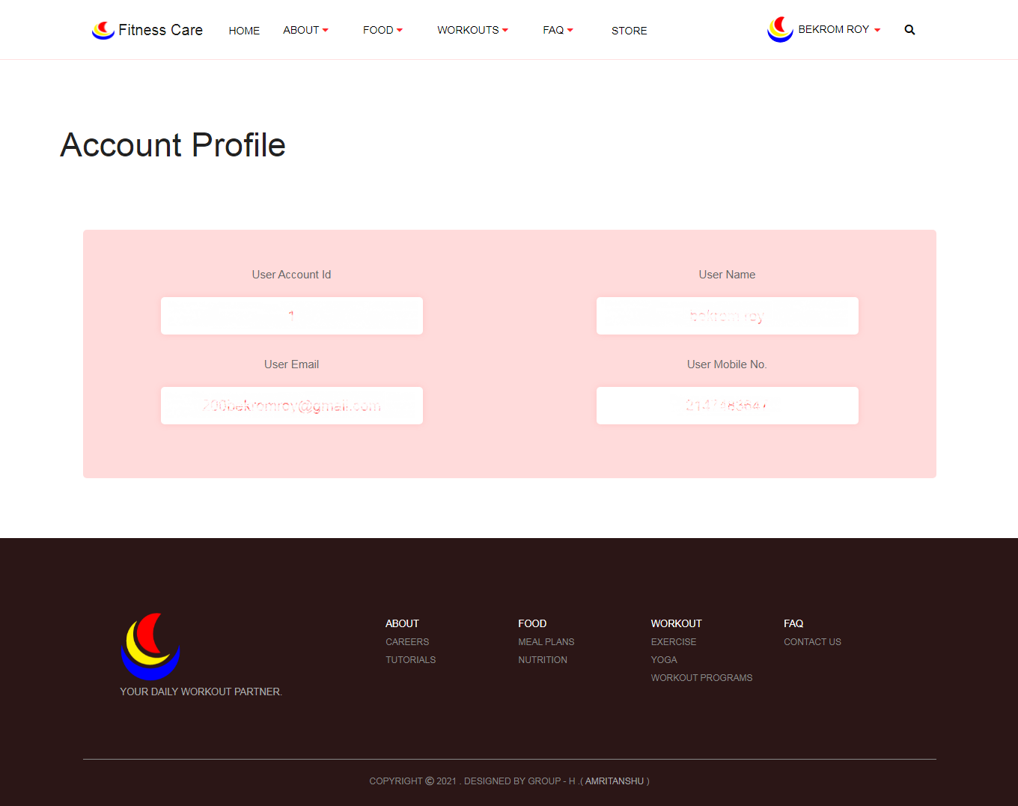
User Account Page
This is user account page of our page. When the user login into his account then only this page shows every details related to user account.
Speaker : Bekrom Roy

Slide 23
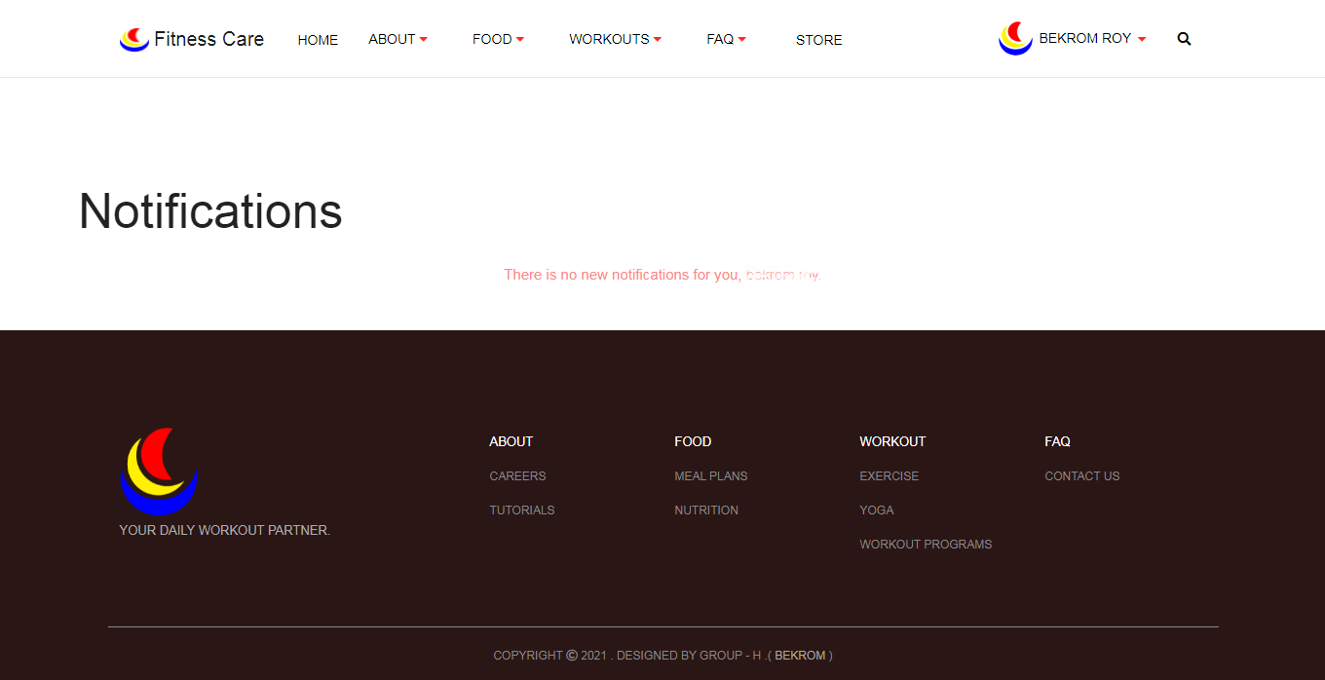
Notification Page
This is user notification page of our website and this page contains any notification update for the user.

Slide 24

Contact Page
This is contact us Page of our website. This page is created for the users who faces any problems related to our website and wants so share his experience about our website. So the user can reach to us easily through this page.

Slide 25


CONCLUSION
After the completion of the project we got to know that how can we utilize our programming skills and to work in a team and what are the actual requirements needed to complete a website .
And lastly we(Group-H) would like to thanks to our teachers for giving us an opportunity to do a project like this and helping us in every step of the project. Without our teachers help it will not be possible to complete this project.

Slide 26
Presented By:- Group - H
THANK YOU

